Slide 1
Deutsche Börse Group
Using JIRA for Change Management
23rd of May 2017 – By Jaroslav Lhotak, Alejandro Sanseverino

Slide 2
Agenda
About the Speakers
Introduction to JIRA
JIRA Workflows and Issue Types - Risk IT
JIRA Setup - Risk IT
JIRA Automation for Change Management
Live Demo
Q&A
Contact Information

Slide 3
About the Speakers
1

Slide 4
About the Speakers
Alejandro Sanseverino
Project Manager, Risk IT
Service Implementation, Prisma
Jaroslav Lhotak
Integrator / Configuration Manager, Risk IT

Slide 5
Introduction to JIRA
2

Slide 6
JIRA 101 – Basic Questions
What is JIRA? In simple terms: “JIRA is an issue tracker”
Is it web based? Yes
Offers API? Yes
Is it a licensed product? Yes
Whose product is JIRA? www.atlassian.com

Slide 7
JIRA 101 – Features (from the creators of JIRA)
Because you've got issues
JIRA lets you prioritize, assign, track, report and audit your 'issues,' whatever they may be — from software bugs and help-desk tickets to project tasks and change requests.
Reporting and statistics
Customizable reporting allows you to monitor the progress of your issues with detailed graphs and charts.
Workflow your way
Map your business process with a custom workflow.
An extensible platform
Integrate JIRA into your systems with our open API and 200+ free and paid plugins.

Slide 8
JIRA 101 – Concepts
Issue
Any type of ticket created in JIRA is an issue.
An issue represents a software bug, a project task, a container for deployment, etc.
Every issue belongs to a particular project.
Workflow
A JIRA workflow is the set of statuses and transitions that an issue goes through during its lifecycle.
Project (Application)
A JIRA project is a collection of issues.
Individual projects will be set up for each of the main applications (PRISMA, RITA, EDRE, etc.).
Component (Technical Area)
A project component is a logical grouping of issues within a project. Each project may consist of various components (or none), depending on the project needs.
Example: Core Engine, GUI, Margin Monitor, etc.
Version
This is useful to associate an issue with a particular project version (baseline).

Slide 9
JIRA Project / Issue Structure
Level 1
Projects
Components
Versions
Level 2
Issues
Issue Type
Issue Type
Workflow
Workflow

Slide 10










JIRA Integration Options
&

Slide 11
JIRA Workflows and Issue Types
3
Risk IT

Slide 12
SIRE vs JIRA – Issue Types
SIRE
Project SIR
Issue
Container
JIRA
Bug
Feature (Requirement, Improvement, Nice-to-Have, Spec Change)
Story
Task (Shared for Dev, Test, Maint, ACT, Funct.)
Sub-Task
Container

Slide 13
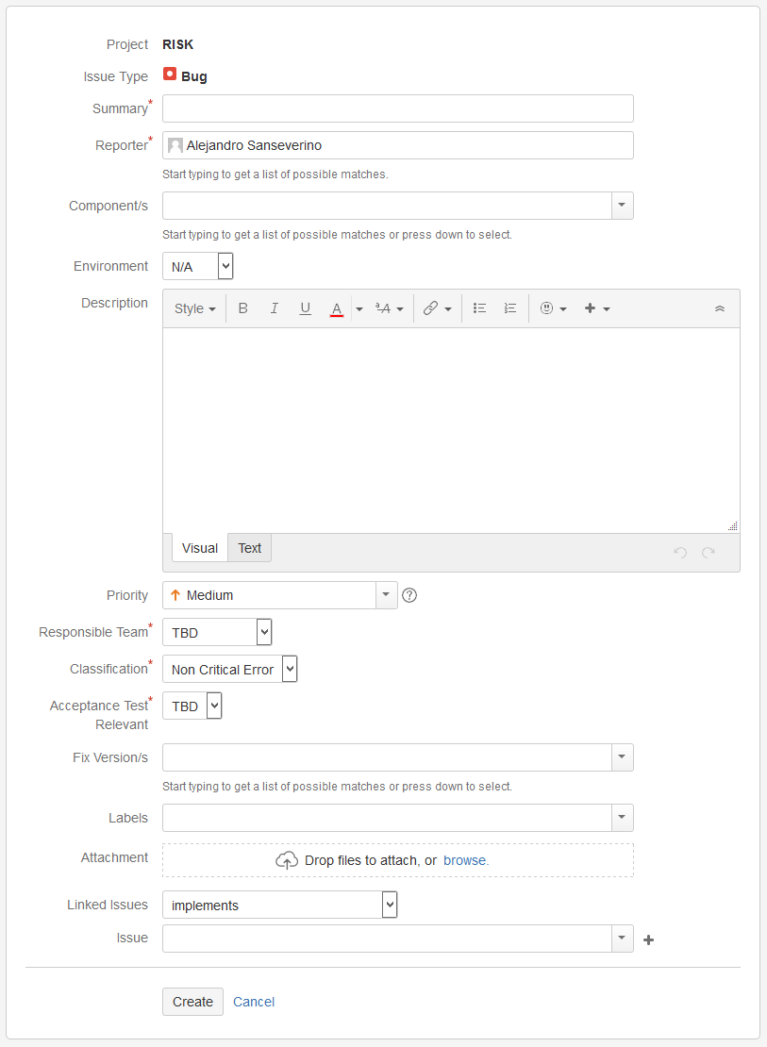
JIRA Issue Type: Bug
Issue Type ‘Bug’ will feature dedicated fields to ease tracking and prioritization:
Responsible Team:
TBD
Maintenance
Project
Classification:
Non Critical Error
Critical Error
Serious Error
Acceptance Test Relevant:
TBD
Yes
No

Slide 14
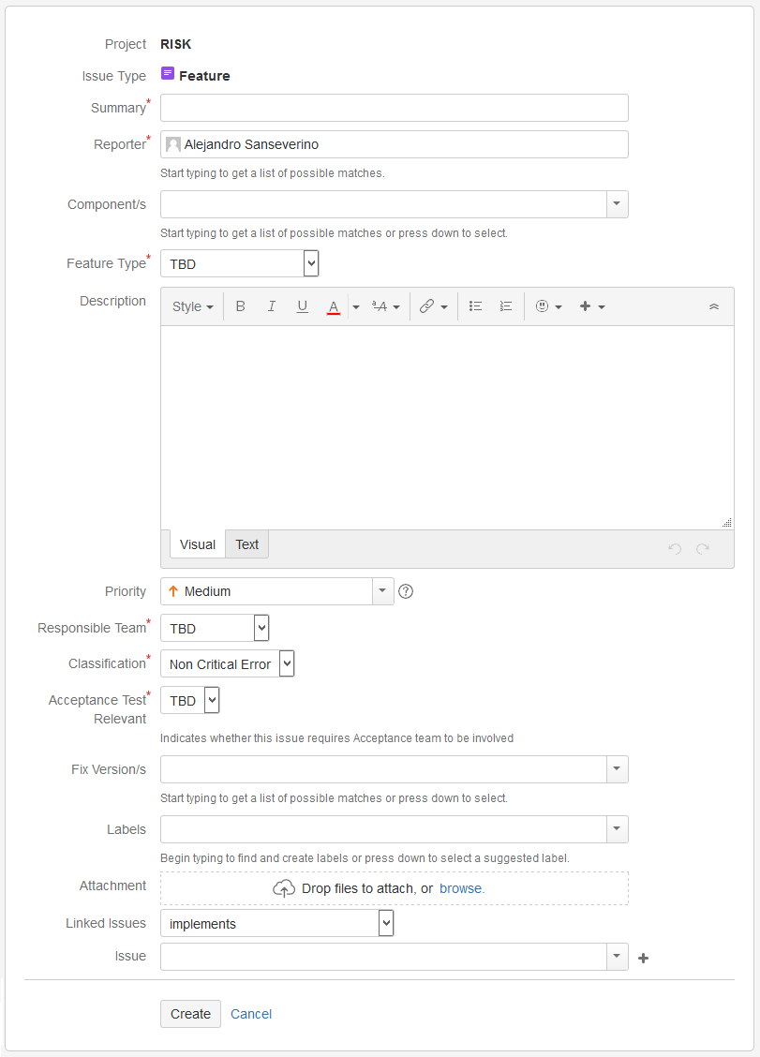
JIRA Issue Type: Feature
Issue Type ‘Feature’ will feature dedicated fields to ease tracking and prioritization:
Feature Type:
TBD
New Requirement
Enhancement
Specification Change
Responsible Team:
TBD
Maintenance
Project
Classification:
Non Critical Error
Critical Error
Serious Error
Acceptance Test Relevant:
TBD
Yes
No

Slide 15
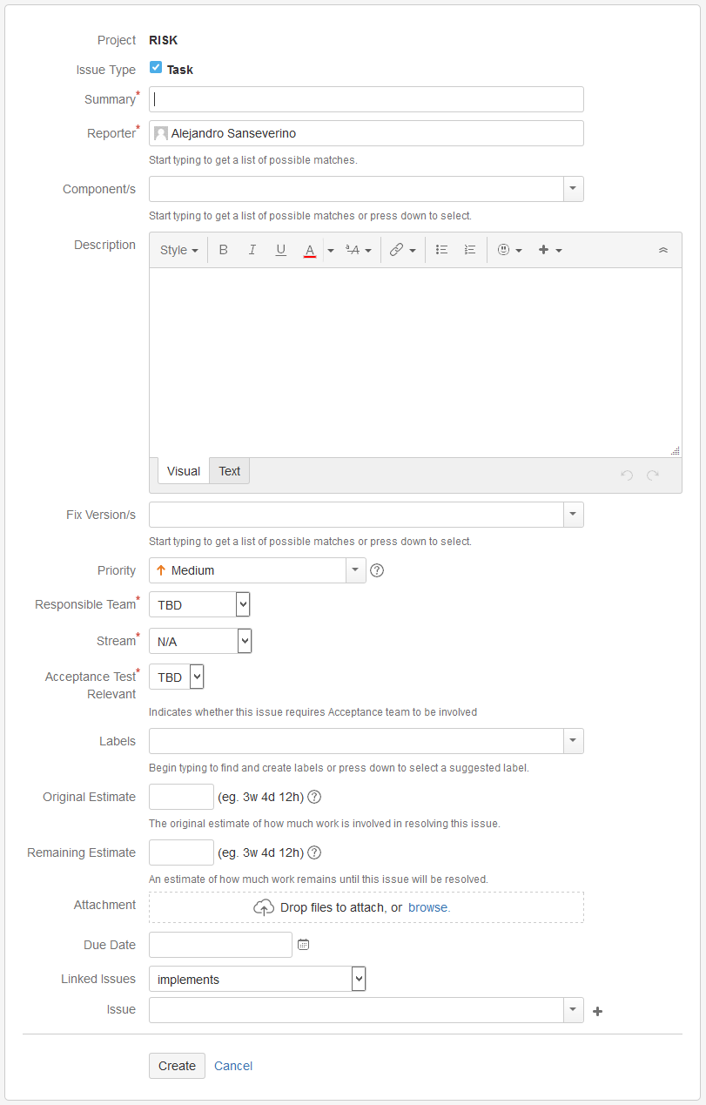
JIRA Issue Type: Task
Issue Type ‘Task’ will feature dedicated fields to ease tracking and prioritization:
Responsible Team:
TBD
Maintenance
Project
Stream:
N/A
Development
Functionality
System Test
Acceptance Test
Acceptance Test Relevant:
TBD
Yes
No

Slide 16
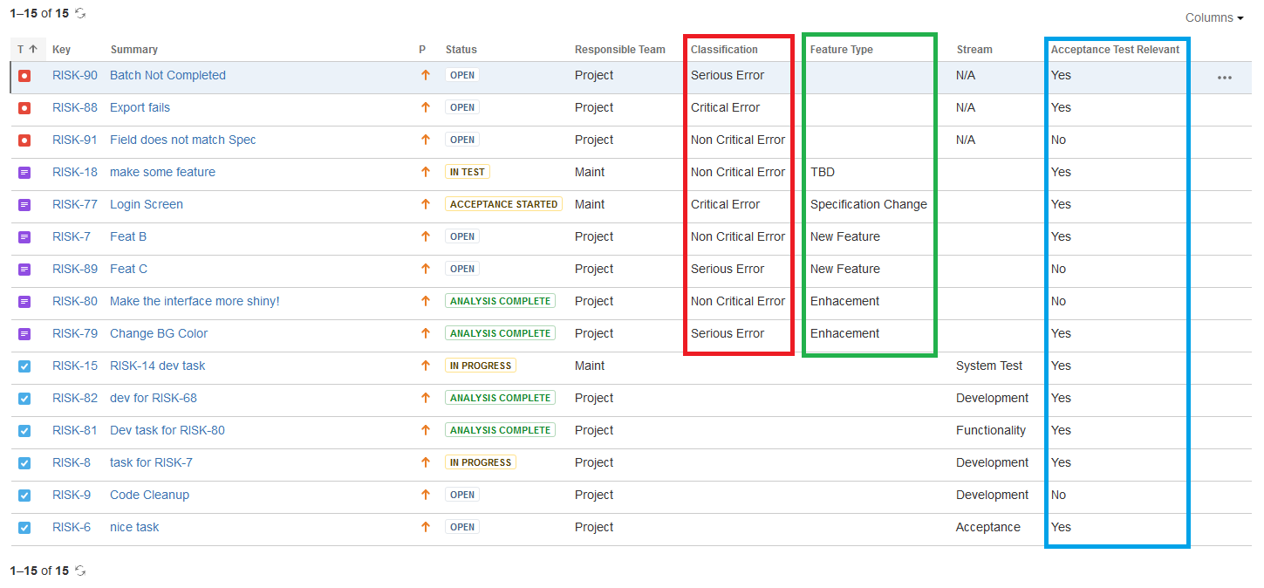
JIRA Reporting

Slide 17
JIRA Workflow Distribution per Issue Type
1. Generic Change Management (Project SIR) :
Bug
Feature
2. Generic Task:
Task
3. Story:
Story
4. Generic Sub-Task:
Sub-Task
5. Container (Container):
Container

Slide 18
JIRA Setup
4
Risk IT

Slide 19
JIRA RiskIT – Setup
Projects:
Prisma
RICA
DWH Production
EDRE Production
RE Production
MDH
DAVe
Risk Admin
RiskIT will have its dedicated schemes to be isolated from other products and ease future updates of relevant items:
Workflow Scheme
Issue Type Scheme
Screen Schemes
Field Configuration Schemes

Slide 20
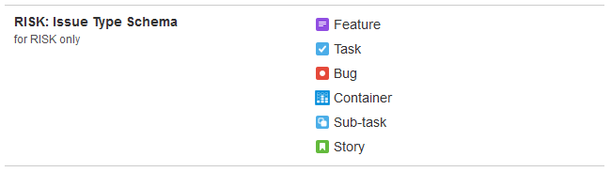
JIRA Risk IT – Issue Type Scheme

Slide 21
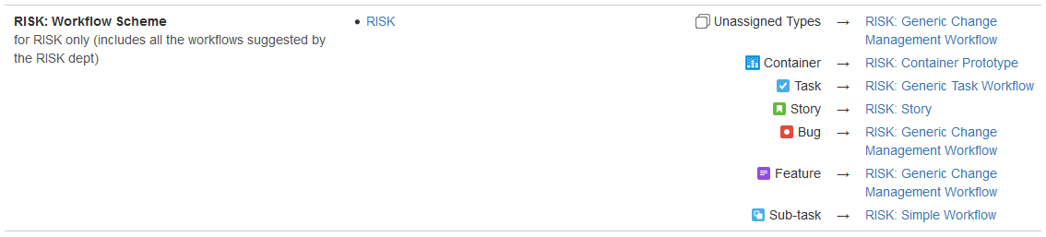
JIRA Risk IT – Workflow Scheme

Slide 22
JIRA Automation for Change Management
5

Slide 23
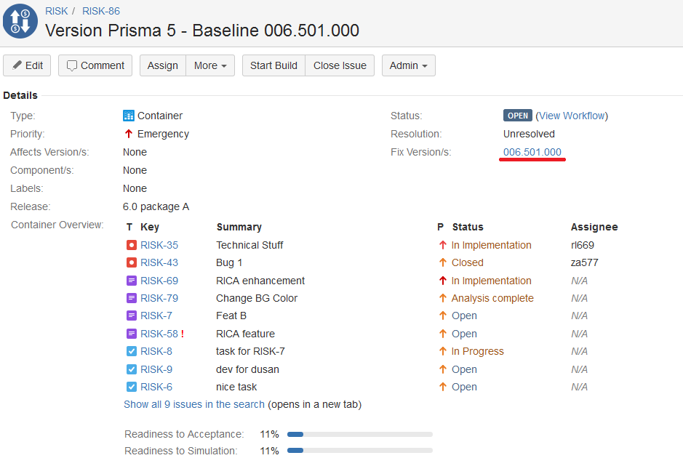
JIRA Issue Type: Container
Issues will be automatically linked to Containers via ‘Fix Version’ field.
No need to manually link any issue types to this particular item.

Slide 24
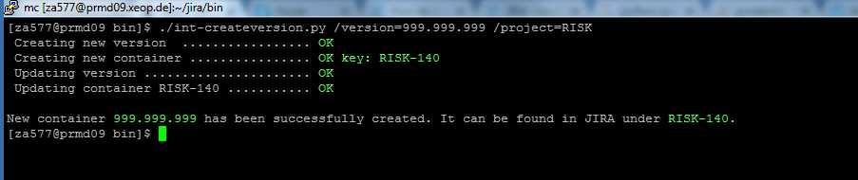
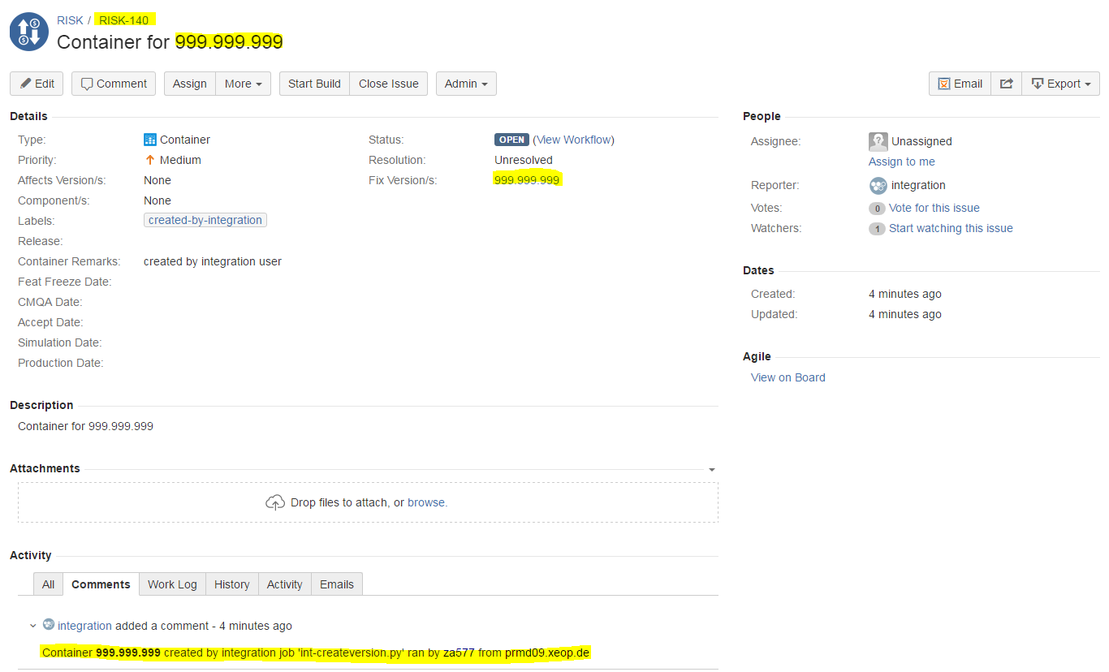
JIRA Automation: Create a new version / container
A new version and empty container can be easily created from a command line.
Implemented for
RiskIT needs

Slide 25
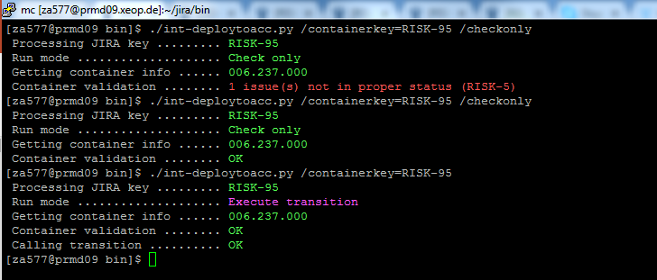
JIRA Automation: Validation and push a container to Acceptance (1/2)
A container and its content can be easily validated to have all included issues in proper status by calling a command line script with /checkonly parameter. See below the first run which failed due to a problem with issue “RISK-5”
The actual push to Acceptance (or any other environment) moves all the included issues, updates statuses and sends proper notifications.
The goal is to integrate this script to the XEOps / CMQA workflow. Screenshots follow on next slide.
Implemented for
RiskIT needs

Slide 26
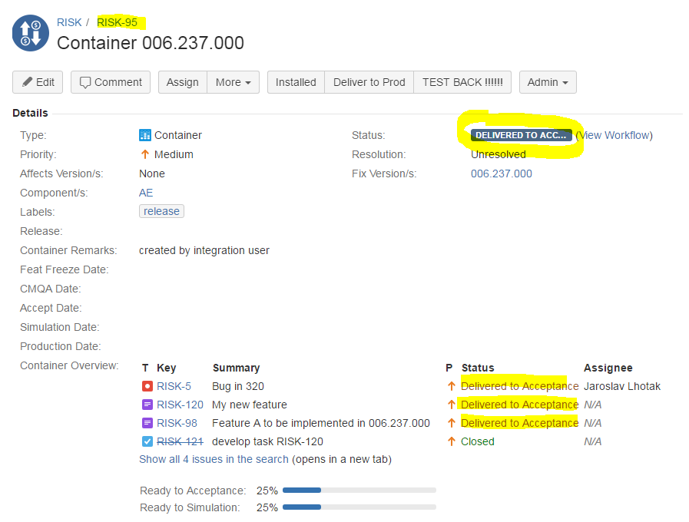
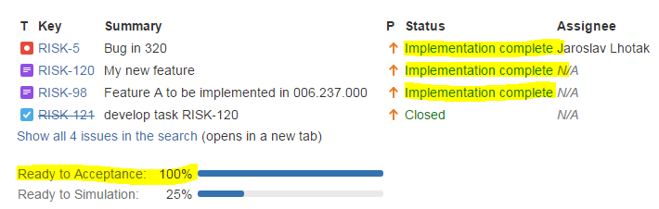
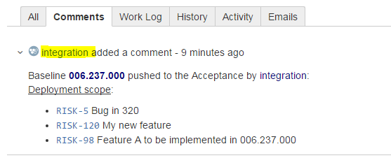
JIRA Automation: Validation and push a container to Acceptance (2/2)
pushed by the script
Implemented for
RiskIT needs
Container and all the relevant issues have been pushed to the
next stage (Delivered to Acceptance).
A deployment comment has been to indicate what issues have been transitioned / pushed

Slide 27




JIRA Automation: Add-on(s) Required
Adaptavist ScriptRunner for JIRA
JIRA Misc Workflow Extensions
Bob Swift Atlassian Add-ons - Clone Plus for JIRA
JIRA Misc Custom Fields

Slide 28
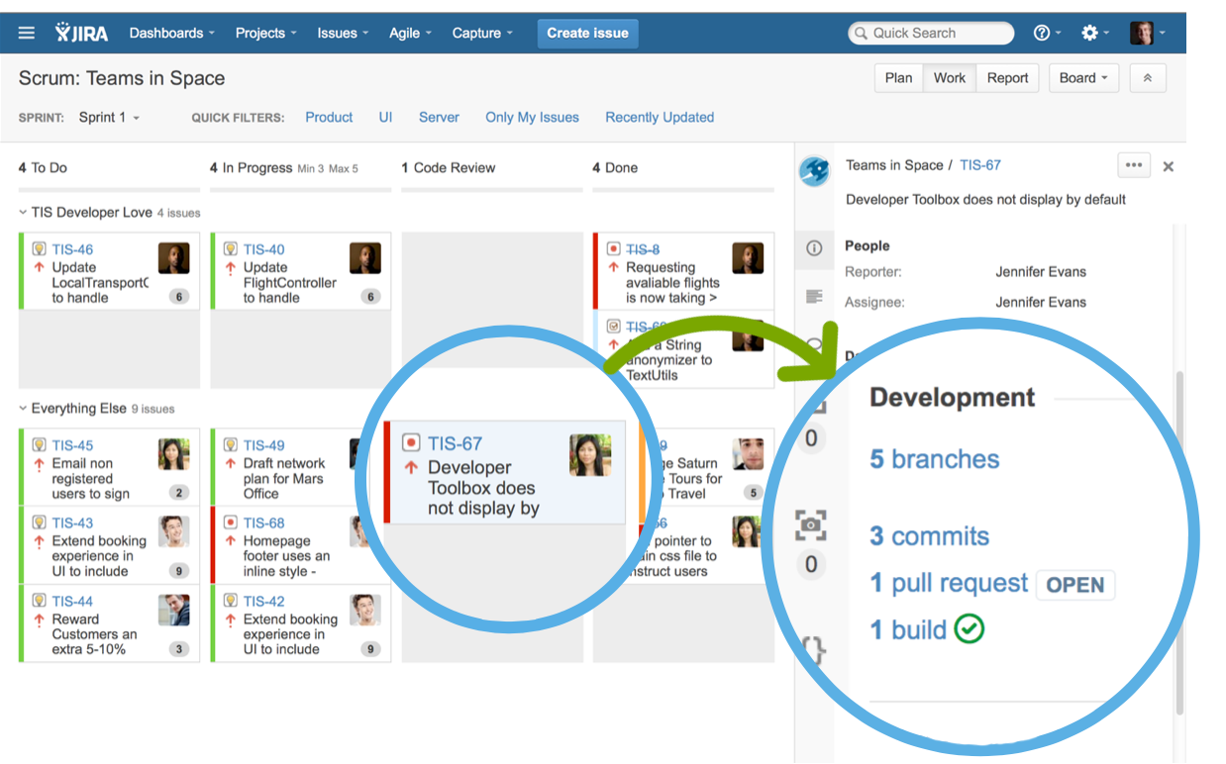

JIRA Integration: Branches Pull Requests and Status Commits (DVCS)

Slide 29
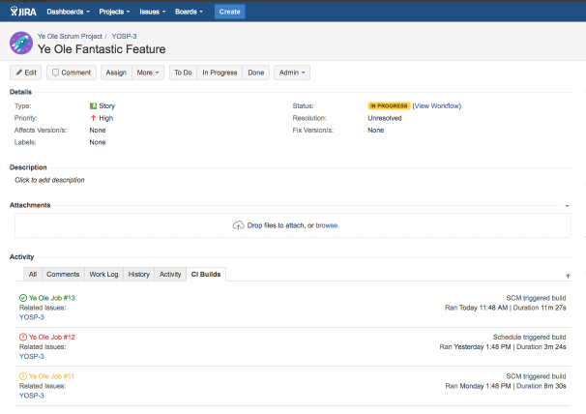

Jenkins Integration for JIRA: List of CI Builds

Slide 30
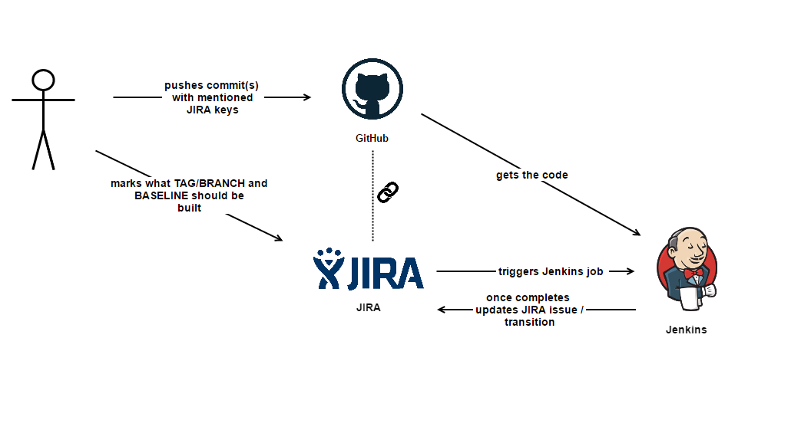
JIRA Integration: Change Management Process

Slide 31
Live Demo
6

Slide 32
JIRA Sandbox
URL: http://sire.rit.deutsche-boerse.de:8080/secure/Dashboard.jspa
Username/Password: Your Citrix Credentials
Project: RISK (RISK)

Slide 33
Q&A
7

Slide 34
Contact Information
Alejandro Sanseverino
Project Manager, Risk IT
Phone +420 29 64 28707 Slack @alex_s E-mail alejandro.sanseverino@deutsche-boerse.com
Jaroslav Lhotak
Integrator / Configuration Manager, Risk IT
Phone +420 29 64 28034 Slack @jaroslav.lhotak E-mail jaroslav.lhotak@deutsche-boerse.com

